Slide 1

Home Automation
A Project by
Akash Mishra (2016BTECS00048)
Anurag Ganjiwale (2016BTECS00056)
Vishwajeesingh Desurkar (2016BTECS00059)
Under the Guidance of
Mr. A.R.Surve

Slide 2
Agenda
Introduction
Objectives
Issues with Current System
Methodologies
UML Diagrams
Fog Computing
Project Modules
Platforms/Technologies being Explored
Key Features
Development Stack
References

Slide 3
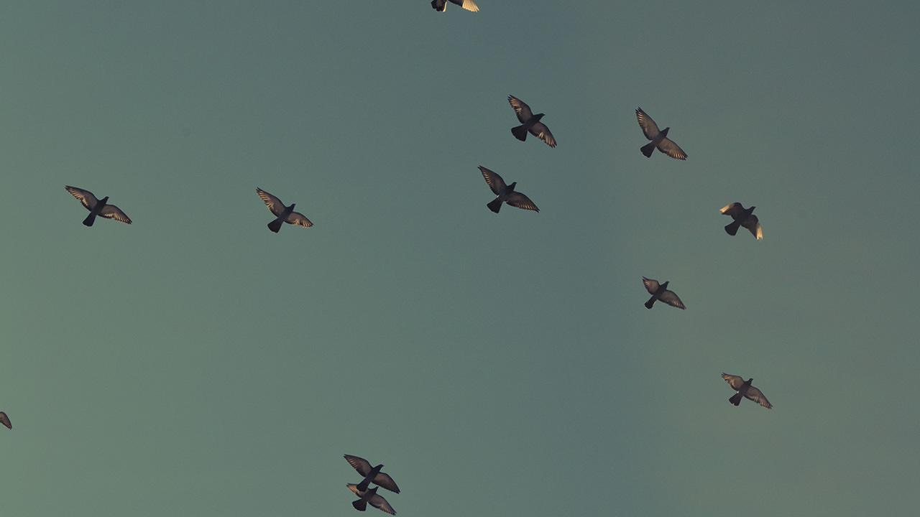
1.
Introduction

Slide 4
As the demand for system with the growing no of smart things and also with growth in human computer interaction taking that smartness to our homes i.e. to use this to enhance our daily life.

Slide 5
This can be achieved using two burning technologies in computer domain i.e.
Internet of Things with Fog Computing
and
Blockchain

Slide 6
2.
Objectives
Develop a real time android app using Angular Native app development.
Collecting real time data using sensors and Raspberry pi.
Enabling system to perform some operations based on that.

Slide 7
3.
Issues with Current System
High Latency
Downtime
Security and privacy
Centralized Infrastructure

Slide 8
High latency :cloud can’t guarantee low latency because of the distance between client devices and data processing centers
Downtime :technical issues and interruptions in networks may occur for any reason in any Internet-based system and make customers suffer from an outage
Security and privacy : private data is transferred through globally connected channels alongside thousands of gigabytes of other users’ information

Slide 9
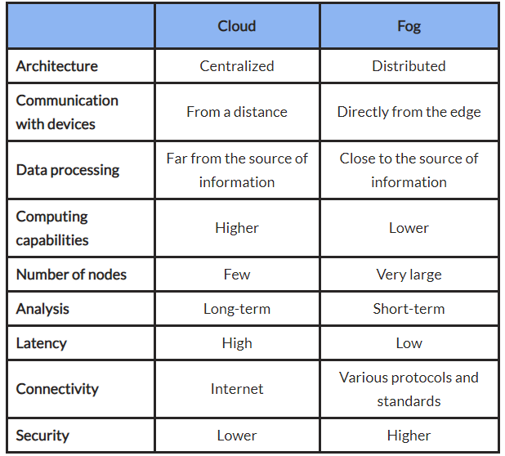
Comparison

Slide 10
4. Methodologies
The major blocks of the System are :
Real Time Data collection using sensor
Android interface with blockchain as backend technology.
All of the above blocks and relationships are represented using UML diagrams.
Use Case Diagram
Class Diagram
Sequential Diagram
We are going to use basic coding techniques to retrieve data through sensors and to manage that data we are going to use Fog Computing.

Slide 11
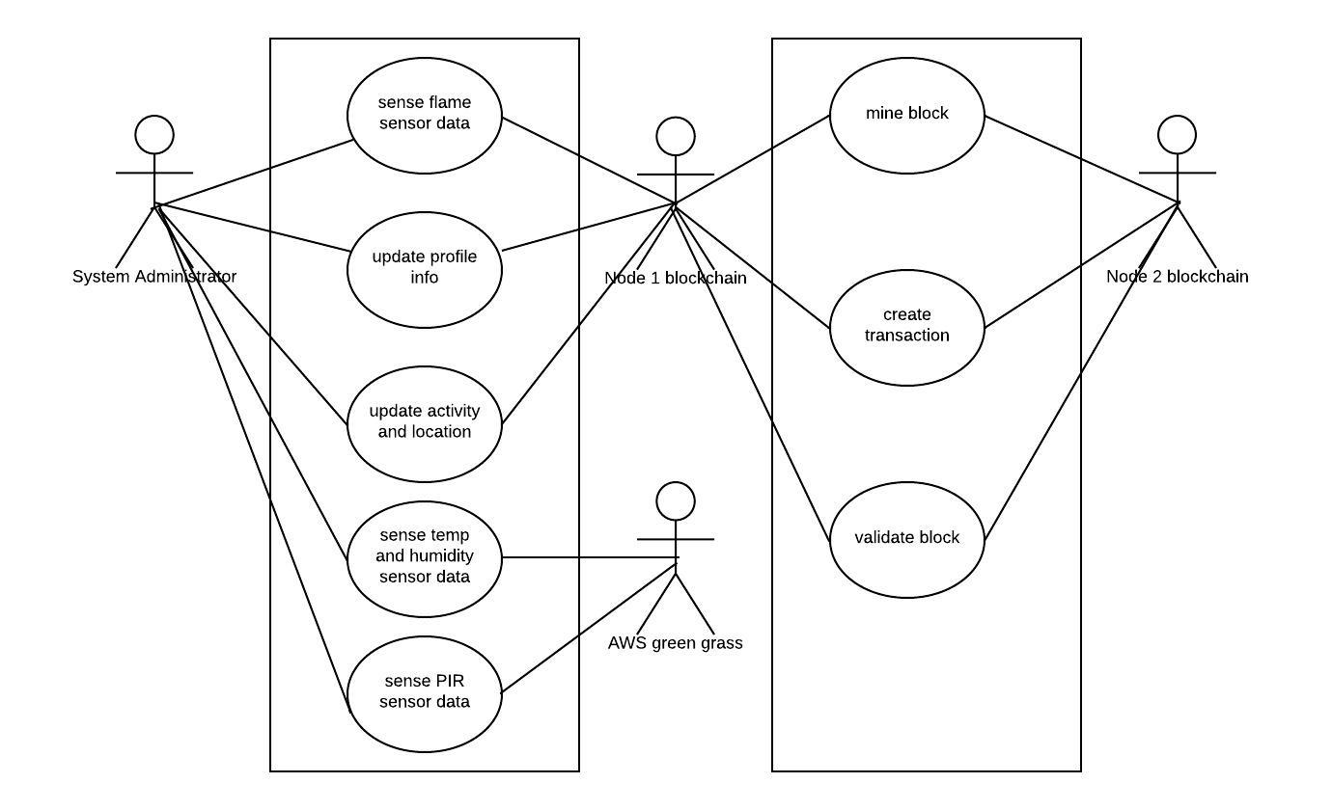
Use Case Diagram

Slide 12
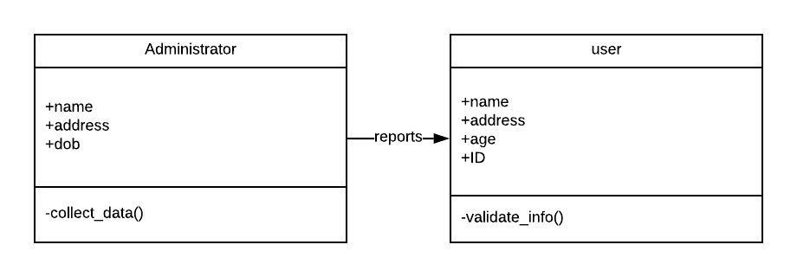
Class Diagram

Slide 13
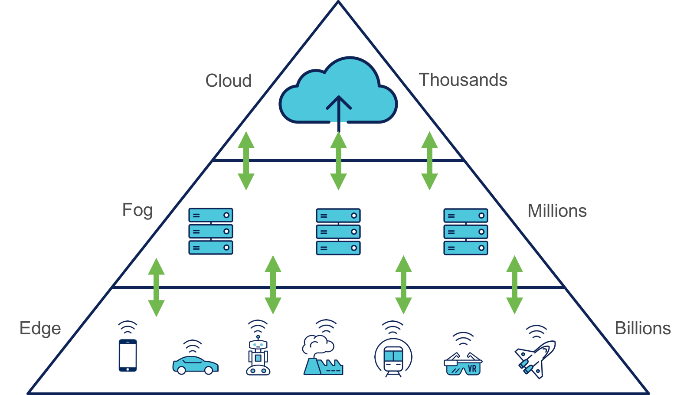
Fog Computing
Fog computing is a decentralized computing infrastructure in which data, compute, storage and applications are located somewhere between the data source and the cloud. Like edge computing, fog computing brings the advantages and power of the cloud closer to where data is created and acted upon.

Slide 14
5. Project Modules
Real Time Data Collection
Collecting real time readings of sensor
Temperature and Humidity Sensor
PIR sensor
Flame Sensor
Blockchain development
developing dapp to transfer important information
Using Ethereum platform to achieve that
Android development
Developing Android application to manage the all the sensors and activities from your phone itself.

Slide 15

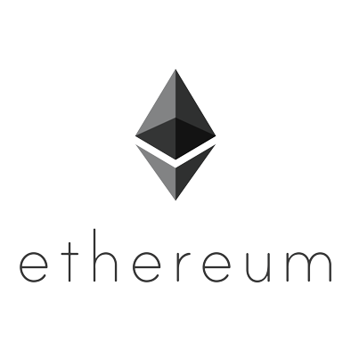

6. Platforms/ Technologies being explored
Raspberry pi
We are going to explore the various aspects used in this platform and with that we are going to explore how to retrieve data from sensors
Blockchain
We are going to explore ethereum platform to perform blockchain operations. We will also going to learn solidity which used to develop dapp over ethereum
AWS
We are going to explore the use of Amazon Web services to hoist an web application and also we are going to use AWS IOT services as well.

Slide 16
7. Key Features
All the data is Digitized.
Less chances of breaches as we are using Blockchain
Fire Alarm
Digitization
Security
We are using Fog computing so the response time increases greatly.
We can continuously monitor using sensors.
Fast response
Real Time Monitoring

Slide 17
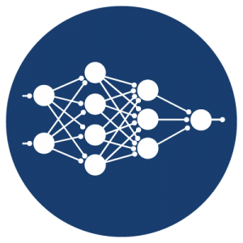
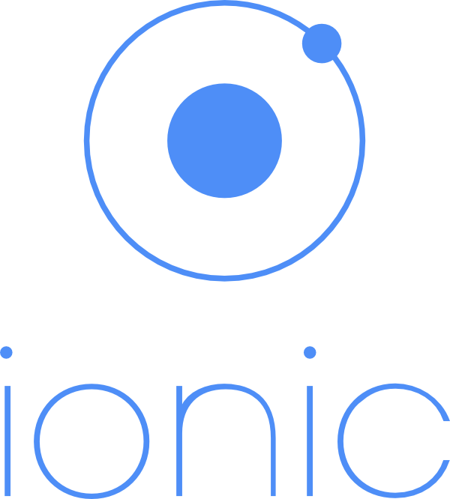
8. Development Stack
Android Stack
IOT Stack
Blockchain
Using Ionic Framework
Angular Js
Sensors modules:
DHT11
Flame sensor
PIR sensor
Microcontroller: Rasberry pi3
Service Platform: AWS IOT( Greengrass)
Programming Language: Solidity
Platform: Ethereum

Slide 18
9. References
ACM Digital Library
IEEE Journals
For Random Forest algorithm: pages.cs.wisc.edu/~matthewb/pages/notes/pdf/ensembles/RandomForests.pdf
To understand Agile development practices:
https://www.agilealliance.org/agile101/

